Slide 1

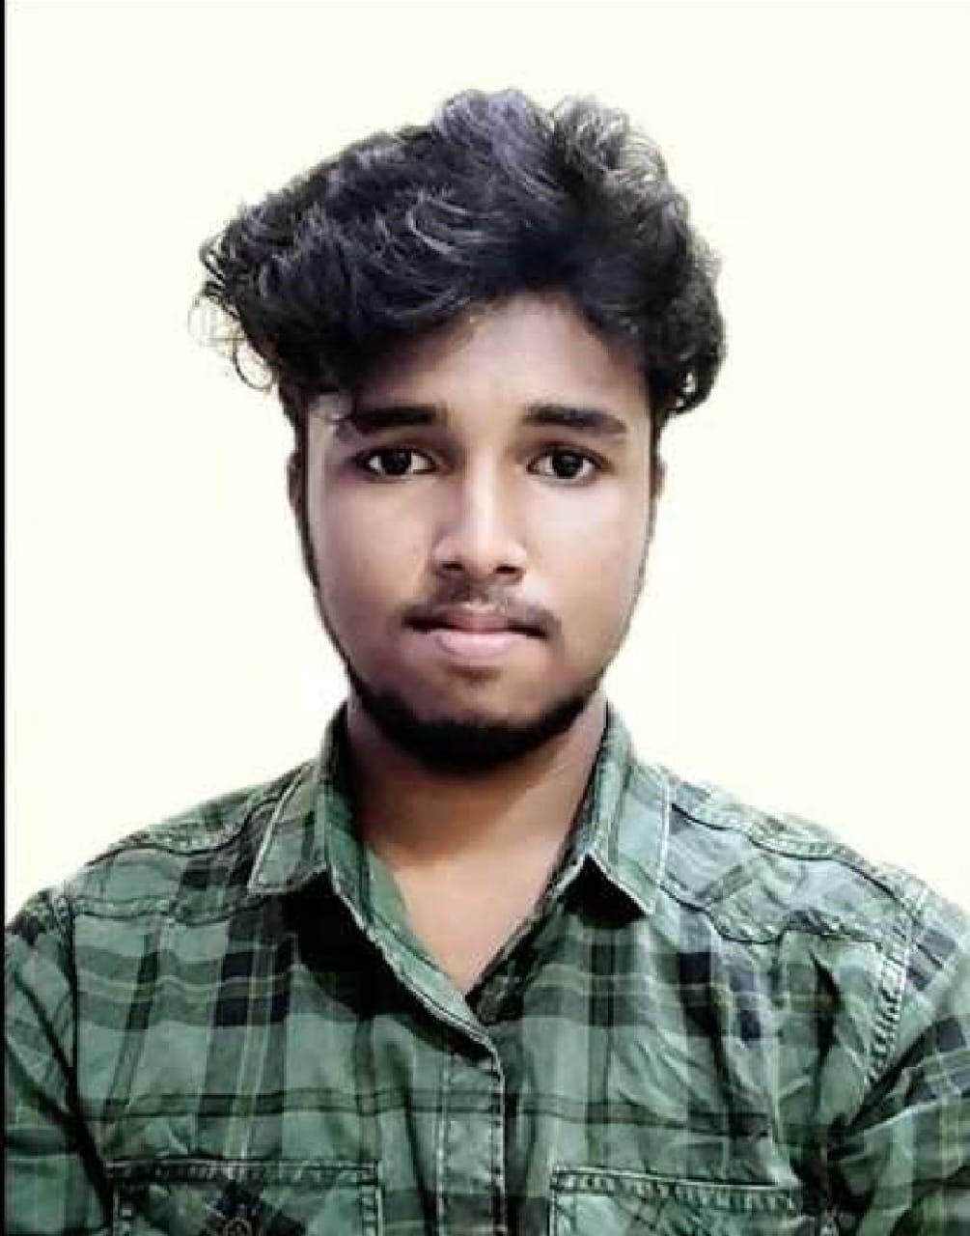
CERTIFICATE OF COMPLETION
TAILWIND MASSAGE
IS HEREBY GRANTED TO
K.S.JAYASURIYAA
TO CERTIFY COMPLETION OF MASSAGE THERAPY TRAINING
SEP 23, 20XX
Taylor Phillips, LMT
Date

